Slide 1
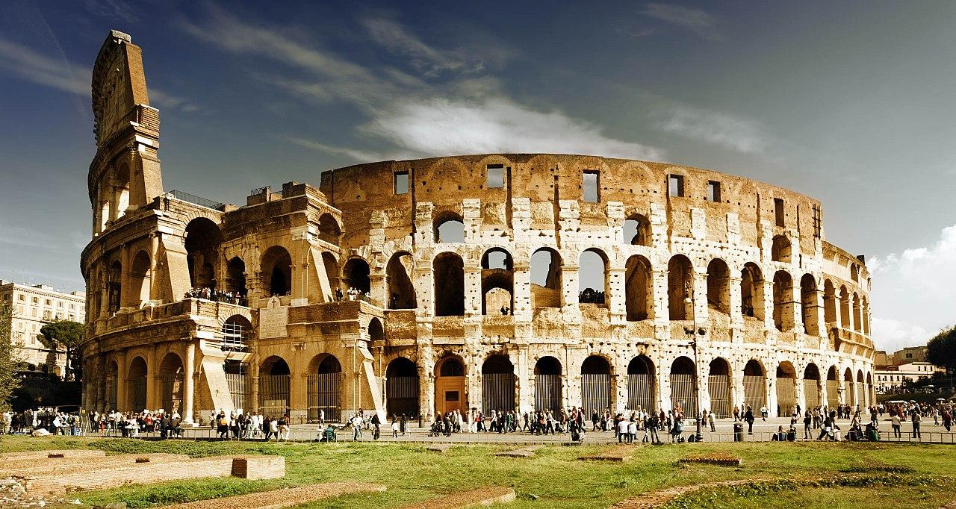
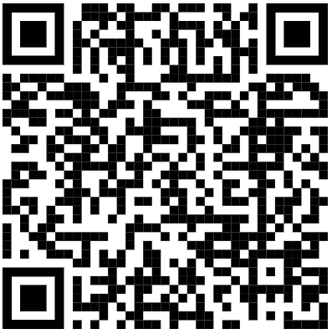
English
Over Terms 5 and 6, Year 3 will write a range of different genres. They will learn how to write a formal letter, poetry, descriptions and narratives.
They will develop their knowledge and understanding of writing techniques such as applying expanded noun phrases and sophisticated vocabulary.
Term Six
Year 3
Emperors and Empires!
Maths
Over Term 6, Year 3 will b developing their understanding of Time and Statistics, as well as consolidation of the four operations.
They will apply their knowledge and understanding of calculations to solve problems both practically and online.
Welcome back to
Year 3!
We have an exciting term ahead of us! If you have any questions please ask your child’s teacher.
P.E.
P.E. will be on a Wednesday and Friday.
Science
In term 6, Year 3 will be learning about Plants. We will learn about the requirements of plants for growth and survival. They describe the parts of flowering plants and relate structure to function, including the roots and stem for transporting water, leaves for making food and the flower for reproduction.
Recommended Reads
History
This project teaches children about the history and structure of ancient Rome and the Roman Empire, including a detailed exploration of the Romanisation of Britain.

Slide 2


French
In this unit, pupils will learn 10 familiar activities that they are able or are not able to do in French. This is one of the first units introducing the negative form, allowing the children to build more interesting and complex sentences including the option of using conjunctions.
Term Six
Year 3
Emperors and Empires!
Physical Education
Over Term 6, the children will be developing their skills in relation to striking and fielding.
They will also, develop the cog of their Real PE, with a focus upon agility.
Language Angels
Log in: Password:
westla1121 lahome
Homework
Homework will be given out on a Friday and is expected to be completed and handed in on the following Wednesday.
Music
This Unit of Work consolidates the learning that has occurred during the year. All the learning is focused around revisiting songs and musical activities, a context for the History of Music and the beginnings of the Language of Music.
Computing
Our focus for Term Six, will be to develop an understanding of iMedia and photography.
Religious Education
In RE, the children will consider the question;
What motivates Humanists to lead good lives?
PSHE
In PSHE, Year 3 will engage in lessons that fall under the category of The Wider World.’ Within this unit, the children will discuss - Tolerance, Care for the Community, Work, Money, Winning and Losing and Change. These all fall under the category of The Wider World. Alongside this, the children will Learn about RSE, which will include: Building self-esteem, knowing how to respond to unwanted physical contact and how to reduce hazards within the home.
Art and Design Technology
Over Term 6, the children will learn about sculpture in. We will base our clay sculptures on our RE focus of Humanism. Then use our painting skills & knowledge to paint our clay sculptures!
Mrs.
Oswald
Mr. Kitney

