Slide 1
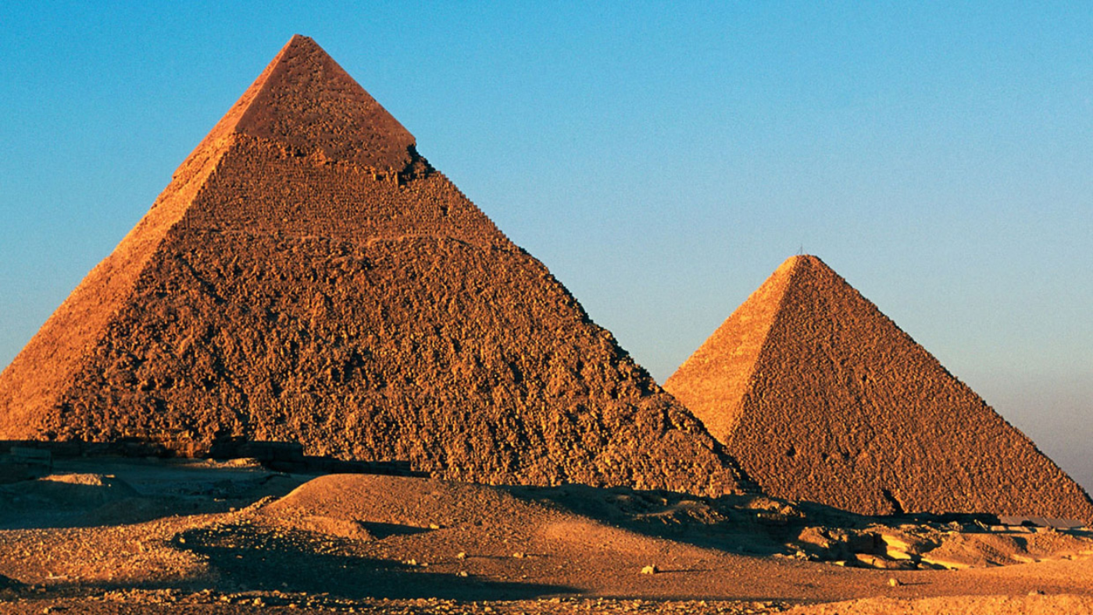
English
Throughout term 6, we will be writing our own poems based on different cultures, writing our own set of instructions, as well as developing our descriptive writing.
Term Six
Year 4
Ancient Civilizations!
Science
This term we will be continuing to study Electrical Circuits and Conductors.They construct simple series circuits and name their parts and functions, including switches, wires and cells.
Welcome back to Term 6!
We have another exciting term ahead of us!
If you have any questions, please speak to your child’s class teacher:
Miss Farrant & Miss Waller
Maths
Within term 6, we will be focusing on shape, statistics and position and direction.
Children will build upon their knowledge of shape as well as looking at lines of symmetry. We will explore the different ways data can be presented and give us information.
P.E.
Starfish Class will have PE on Monday and Thursday.
Otter Class will have PE on Tuesday and Thursday.
Recommended Reads
Alex sparrow and the really big stink by Jennifer Killick.
The Breakfast Club Adventures: The Beast Beyond the Fence by Marcus Rashford
How To Train Your Parents by Pete Johnson
The Last Firefox by Lee Newbery
History
We are continuing our study on ancient civilisations and will learn about Ancient Egypt and the Indus Valley throughout term 6. We begin with our exciting enrichment day and will go on to look at the hierarchy, tombs and the role of a pharaoh within Ancient Egyptian times.

Slide 2
French
Within French, we are going to focus on ‘seasons’ and also revise core vocabulary based on colours and numbers.
Term Six
Year 4
Ancient Civilisations!
Physical Education
Children will focus on health and fitness and also striking and fielding games throughout their PE lessons.
Computing
Throughout Computing, we will be looking at photographic techniques, using framing, orientation and digital filtering to create more meaningful and engaging images.
Homework
Homework will still be given out on a Friday and is expected to be completed and handed in on the following Wednesday, or earlier.
Your child will receive a termly menu. They can choose one activity a week and bring this into school. On a weekly basis they need to learn their spellings and times tables. There will be weekly tests in school based on these.
Music
Our learning is focused around creating and presenting a performance!
Students will present what has been learnt in the lesson with confidence. They will introduce the performance with an understanding of what the songs are about and any other connections.
PSHE
This term we consider the ‘Wider World’ and turn to issues of tolerance, caring for the community, work, money, winning and losing and change. In our SRE lessons we name the external parts of male and female bodies that are necessary for making a baby and think about some of the changes puberty brings to our bodies.
Religious Education
Throughout our RE lessons, children will continue to look at HINDU DHARMA and consider the question:
What does it mean to be a
Hindu in Britain today?
DT
This term, DT will focus on home furnishings and the significant designer William Morris. They will learn techniques for decorating fabric, including block printing, hemming and embroidery and use them to design and make a fabric sample.
Google Classroom Codes
Otter: 5btsnerk
Starfish: 5vseq3es

