Slide 1
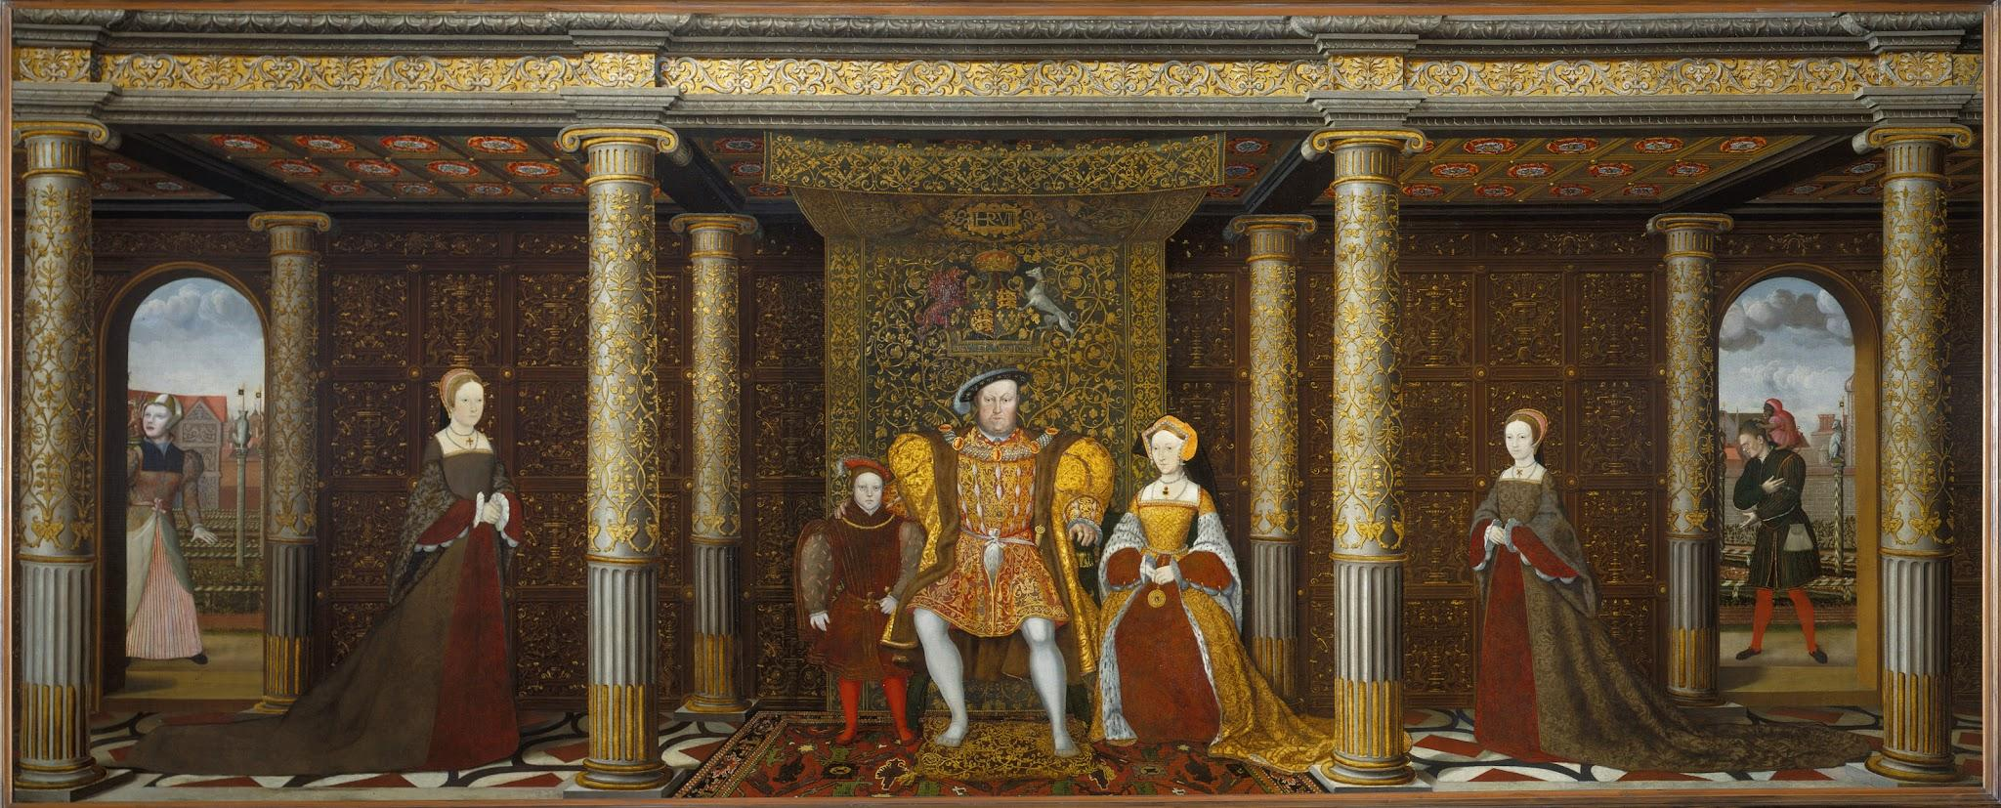
English
This term, the children will learn to write a biography (about a famous Tudor).
THey will also retell a story based on a book we will read. FInally, the pupils will write letters.
Year 5’s reading text will continue to be “Wild Boy’ by Rob Lloyd Jones.
Term Six
Year 5
Off With Their Heads
Maths
This term we will continue to work on arithmetic in our groups, as well as move on to negative numbers, converting units and the volume of shape. We will also be completing some more Maths papers to prepare them for Year 6.
Welcome Back to Year 5!
We have another exciting term ahead of us! If you have any questions please ask your child’s teacher, Mr Miles, Mr Holliday or Mr Kimber.
Recommended Reads
Glassborn by Peter Bunzl
Dungeon Runners: Hero Trial by Kieran Larwood
Skandar and the Unicorn Thief by A.F Steadman
Artemis Fowl by Eoin Colfer
Art
Our focus will be on sculpture, with particular reference to the work of WIll Kurtz.
Pupils will work to create a 3D self portrait.
History
The children will continue to learn about the history of The Tudors! We are going to focus on Henry VIII in more detail, as well as his children. Children are going to take on the role of Henry VIII in a special hot seating lesson too!

Slide 2
Computing
Year 5 will be film producers! We will capture our own footage using a range of cinematic camera techniques,, then use video editing software to make a final cut.
Term Six
Year 5
Off With Their Heads
Music
We will continue our ukulele lessons with Mr Singer.
Science
Science this term will continue to look at properties and changes in materials. We will look at filtering, evaporation and reversible and irreversible changes.
THe pupils will explore how to write scientific reports, with a focus o nursing scientific vocabulary.
Religious Education
In R.E, Year 5 will be looking at Islam. We will seek to answer the question, ‘What does it mean to be a Muslim in Britain today?’
French
In French, we will revisit and consolidate our learning for this year (weather, clothes etc.)
Physical Education
Platypus will have two outdoor PE lessons on a Monday and Tuesday.
Crocodile will have indoor PE on a Monday and outdoor on Wednesday
Kingfisher will have outdoor PE on Wednesday. Kingfisher class will only have one PE lesson due to Forest School.
PSHE
PSHE this term will be focusing on “Wider World.”
We will discuss key themes, such as money, work, winning and losing and change.
Our careers this term are; RSPCA Inspector and Religios Leader.
.
Homework
Spellings and times tables will still be sent home each week with spelling tests being held on a Friday. Alongside this your child will have various tasks that they can complete for bonus Dojo points!

